Slide 1
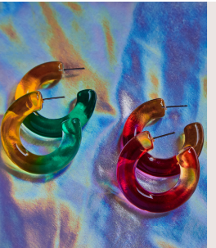
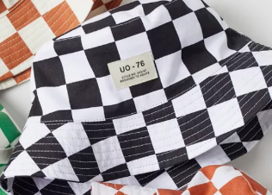
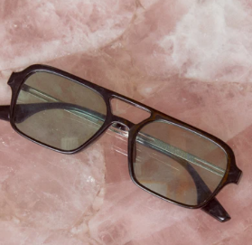
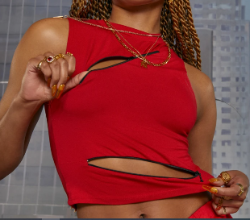
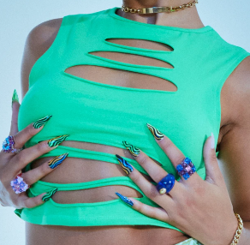
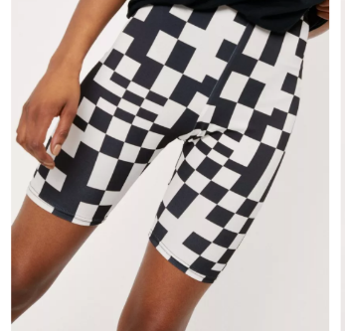
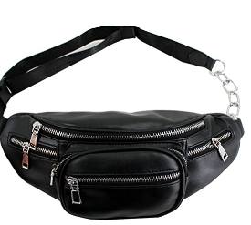
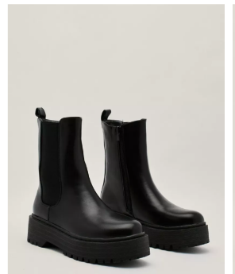
Outfit 1
Hat: www.urbanoutfitters.com
UO Checkered Bucket Hat
Tops: www.jadedldn.com
SLEEVELESS 90'S TEE WITH SLASHED ZIP DETAIL
GREEN SLASH DETAIL CROP TOP
Bottoms: www.nastygal.com
Abstract Check Print Longline Biker Shorts
Boots: www.nastygal.com
Pu Flatform Chelsea Boots
Bag: www.amazon.com
LABANCA
Womens Faux Leather Waist Packs Leisure Chain Belt Ches
Sunglasses: www.jadedldn.com
BLACK & GREEN LENS SUNGLASSES
Earrings: www.8otherreasons.com

Slide 2
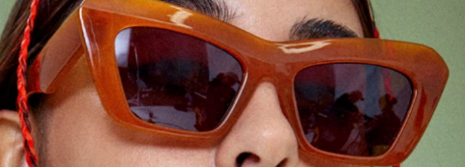
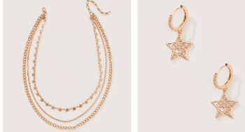
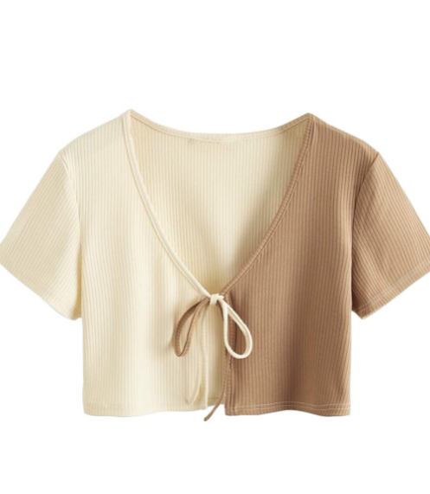
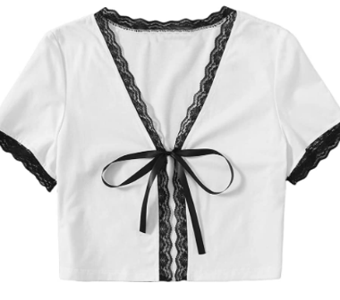
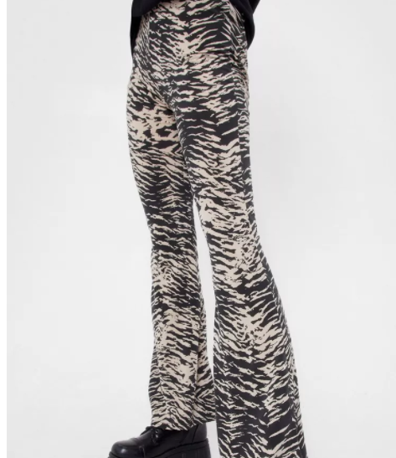
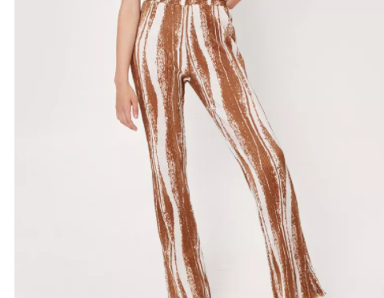
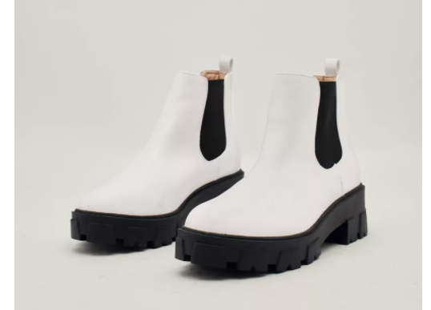
Outfit 2
Tops: www.amazon.com
SweatyRocks Women's Tie Up Crop Top Short Sleeve Ribbed Knit Open Front Cropped Shirts
Bottoms: www.nastygal.com
Zebra High Waisted Flare Pants
Abstract Wave Print High Waisted Flared Pants
Bag: www.amazon.com
LABANCA
Womens Faux Leather Waist Packs Leisure Chain Belt Ches
Sunglasses: www.jadedldn.com
BURNT ORANGE RECTANGLE SUNGLASSES
Boots: www.nastygal.com
Cleated Faux Leather Chelsea Boots
Jewlery: www.8otherreasons.com

Slide 3
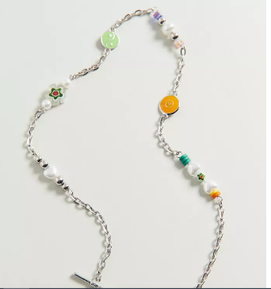
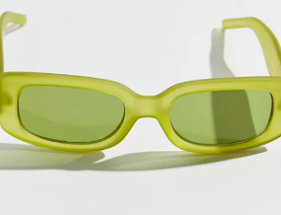
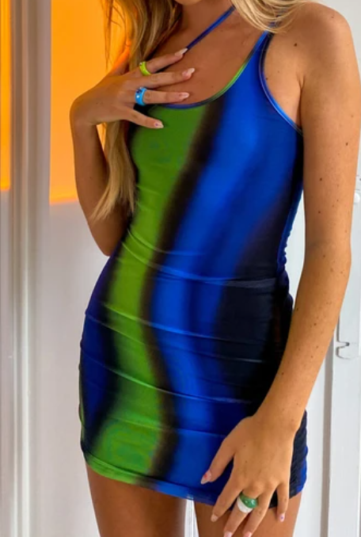
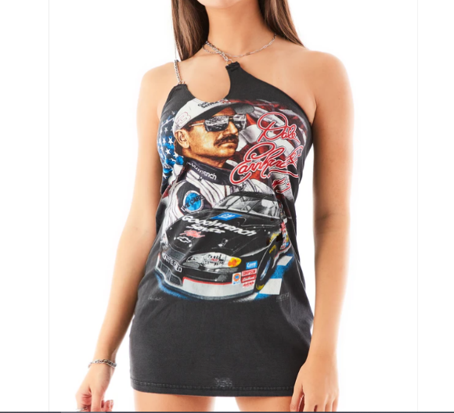
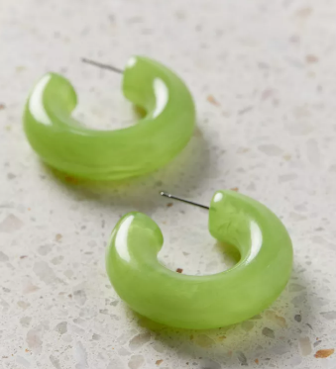
Outfit 3
Dresses:
www.lfstores.com
VINTAGE ONE SHOULDER DOUBLE CHAIN STRAP DRESS
2. www.motelrocks
MOTEL X OLIVIA NEILL Ranti Bodycon Dress in Solarized Green and Blue
Sunglasses: www.urbanoutfitters.com
Topanga Matte Rectangle Sunglasses
Boots:www.nastygal.com
Cleated Faux Leather Chelsea Boots
Bag: www.amazon.com
LABANCA
Womens Faux Leather Waist Packs Leisure Chain Belt Ches
Jewlery: www.urbanoutfitters.com
Resin Statement Hoop Earring
Monica Beaded Toggle Chain Necklace

